Slide 1

Motor Vehicle Crashes
By Hanna Bohannon

Slide 2
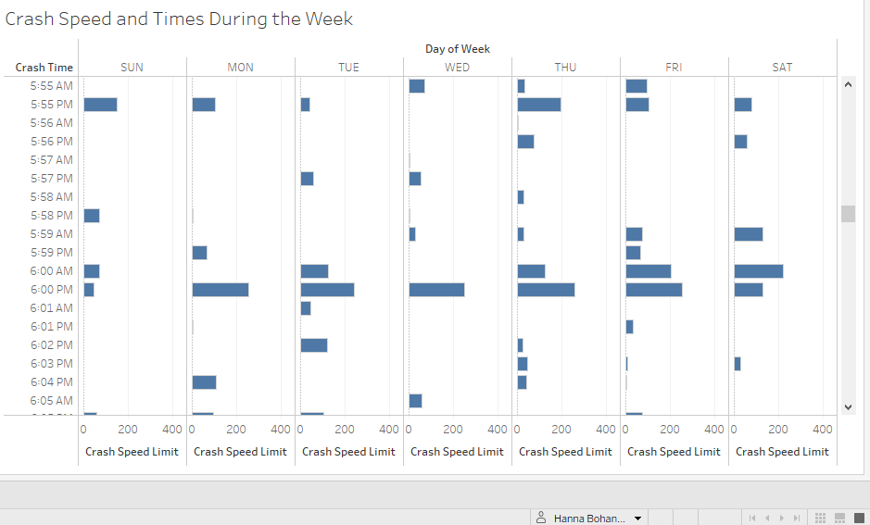
Times of Motor Vehicle Crashes
Here you can see that Crashes happened more often during the week at 6 p.m. This is most likely is due to commute from work and school to home.

Slide 3
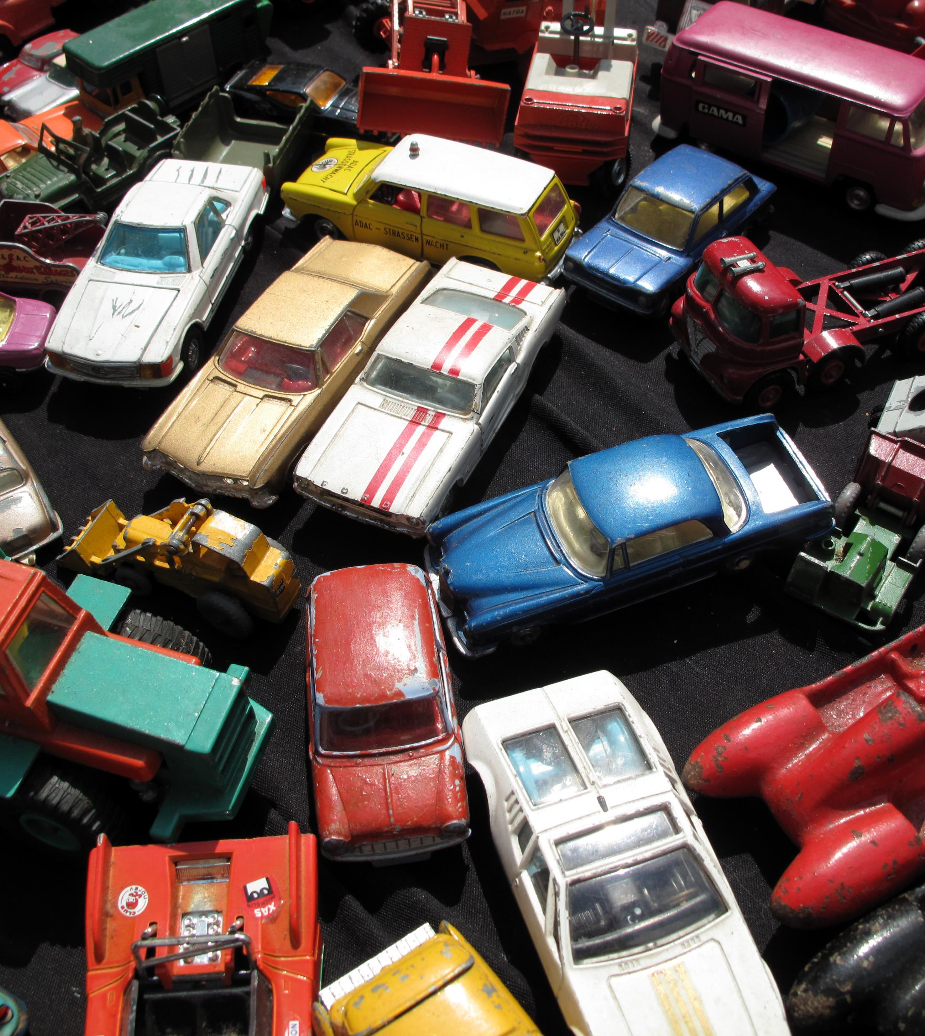
Summary
This data was collected in Texas in 2014 and was aimed at collecting on-scene information about the events and associated factors leading up to crashes involving motor vehicles. However, very little facets of crash occurrences was investigated during my data wrangling due to missing data.
The data I’m presenting has a IV of Crash Time as Continuous data type. There aren’t any level variables while there are two DV. The DV are the Day and Crash Speed Limit as categorical data type. The levels of the DV are Crash Speed Limit, Weekday and Weekend where there were significant and distinct times of day where crashes happened with higher speeds. The most appropriate analysis for this data would be Bhapkar Chi-Square.

